Slide 1
MACHINE LEARNING | 25SC2107E | ACADEMIC YEAR 2026–27
Multi-Task CNN-Transformer for Joint OTFS Channel Estimation and Doppler-Sensing Prediction
PRESENTED BY
Srikar Prathap
2520040006
Dakshesh Kumar
2520040060
Dhanush Karthikeya
2520040032
Under the guidance of Mr. N Lava Prasad, Assistant Professor, Department of ECE

Slide 2
MOTIVATION
Significance of High-Mobility Wireless Communication
Orthogonal Time Frequency Space (OTFS) modulation is designed to support reliable wireless communication in high-mobility environments. However, vehicle movement, multipath propagation, and Doppler shifts cause wireless channels to change rapidly. Accurate channel estimation and Doppler prediction are essential for improving receiver performance. This project uses a CNN-Transformer model to learn channel features and perform both tasks jointly.
01
02
03
04
Autonomous Vehicles
Drones and UAVs
High-Speed Trains
5G and 6G Networks
Reliable wireless communication under rapidly changing vehicle speeds.
Communication support during high-speed flight and movement.
Channel estimation under high Doppler shifts and rapid channel variation.
Machine-learning-based signal processing for future wireless systems.
Joint channel estimation and Doppler prediction can support adaptive and reliable OTFS receivers in high-mobility environments.
2

Slide 3
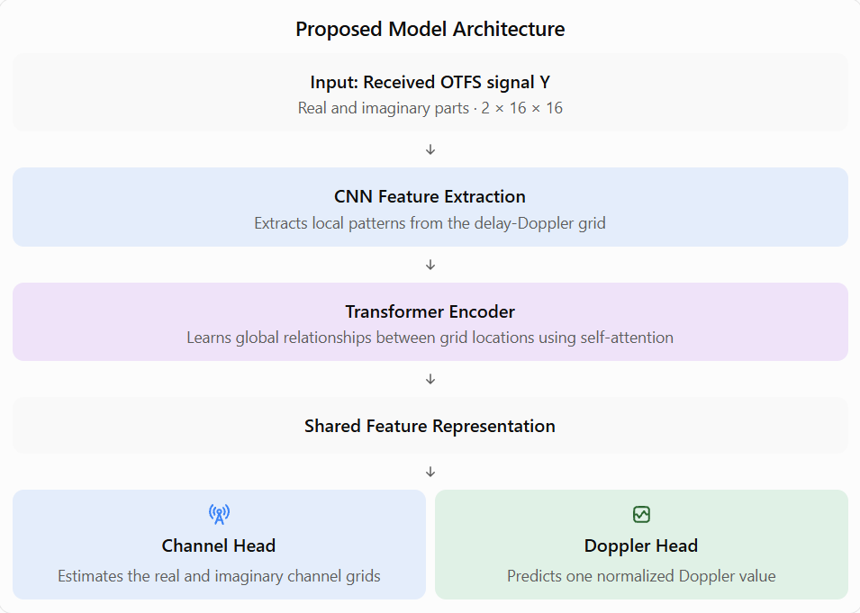
PROBLEM STATEMENT
Problem: Develop a machine-learning-based approach that jointly performs channel estimation and Doppler-sensing prediction from OTFS received signal data.
Proposed idea: Our project proposes a deep learning model that jointly performs OTFS channel estimation and Doppler-sensing prediction using a shared CNN-Transformer architecture.
Wireless channels vary rapidly due to user mobility and multipath propagation.
Noise and Doppler effects make accurate channel estimation difficult.
Separate channel estimation and Doppler prediction can require additional processing.
A joint CNN-Transformer model is explored to learn shared features for both tasks.
3

Slide 4
PROPOSED METHODOLOGY
A Joint CNN-Transformer Approach
The proposed approach uses a Convolutional Neural Network (CNN) to extract local features from the OTFS delay-Doppler input. These features are converted into tokens and processed by a Transformer encoder to learn relationships between different delay-Doppler bins. The shared representation is used for channel estimation and Doppler-related prediction.
CNN FEATURE EXTRACTION
TRANSFORMER ENCODER
Extracts local patterns and features from the received OTFS signal.
Learns long-range relationships between delay-Doppler bins using attention.
MULTI-TASK LEARNING
JOINT PREDICTION
Uses shared features for channel estimation and Doppler prediction.
Produces channel response estimates and Doppler-related predictions.
4

Slide 5
ALGORITHM
Model Architecture and Training Pipeline
The architecture combines CNN-based feature extraction and Transformer-based sequence modelling. The extracted features are used by separate output heads for channel estimation and Doppler prediction.
STAGE 1
STAGE 2
STAGE 3
STAGE 4
OTFS Input
CNN Encoder
Transformer Encoder
Multi-Task Output
Prepare the received delay-Doppler grid with real and imaginary components.
Extract local channel features using convolutional layers.
Process feature tokens to learn long-range dependencies.
Predict the channel response and Doppler-related information.
Backbone: CNN feature extractor followed by Transformer encoder.
Input: 32 × 32 delay-Doppler grid with two channels.
Output: Channel estimation and Doppler prediction.
Training: Joint optimization using suitable channel estimation and Doppler prediction losses.
5

Slide 6
IMPLEMENTATION
Project Workflow
STEP 1
STEP 2
STEP 3
Generate synthetic OTFS channel samples with multipath and Doppler effects.
Add noise and prepare the received delay-Doppler input data.
Extract local features using CNN layers.
STEP 4
STEP 5
STEP 6
Reshape CNN features into tokens for Transformer processing.
Develop and train the joint channel estimation and Doppler prediction model.
Evaluate model predictions using estimation and prediction metrics.
ToolsPython, Google Colab, TensorFlow/Keras, NumPy, Matplotlib, and Scikit-learn.
6

Slide 7
SIMULATION SETUP
Experimental Setup and Evaluation Plan
Simulation parameters
Evaluation plan
Parameter | Specification
Modulation | OTFS-like delay-Doppler representation
Input Channels | Two channels representing signal components
Channel model | Synthetic multipath channel
Noise | Additive White Gaussian Noise (AWGN)
Dataset | 5,800 synthetic samples
Data split | 4000 training, 800 validation, 1000 testing
1
Mean Squared Error (MSE) for channel estimation.
2
Normalized Mean Squared Error (NMSE) for channel estimation.
3
Mean Absolute Error (MAE) for Doppler prediction.
4
Root Mean Squared Error (RMSE) for Doppler prediction.
5
Performance comparison across different SNR levels.
7

Slide 8
REMAINING WORK
Roadmap to Project Completion
No. | Task | Description
1 | Complete Transformer Encoder | Implement attention and Transformer layers on CNN-generated tokens.
2 | Develop Multi-Task Output Heads | Create separate outputs for channel estimation and Doppler prediction.
3 | Train and Evaluate Model | Train the model and calculate MSE, NMSE, MAE, and RMSE.
4 | Final evaluation and report | Analyse results, compare baseline models, and prepare final documentation.
8

Slide 9
CONCLUSION
A Deep-Learning Approach to Joint OTFS Channel Estimation and Doppler Sensing
Uses CNN layers to extract channel features from OTFS delay-Doppler data.
Future work includes comparative evaluation, and testing under different channel conditions.
Thank you

Slide 10
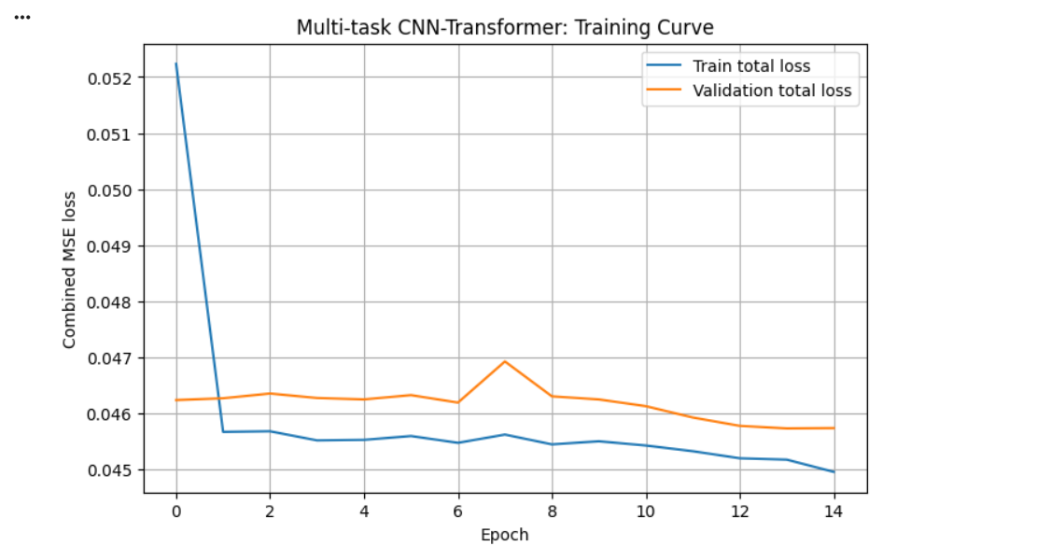
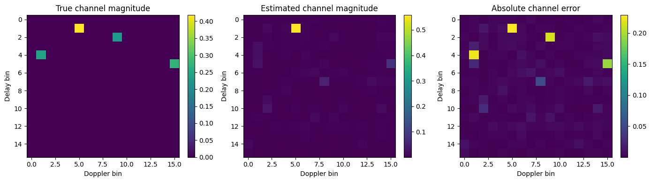
Output:

